Slide 1
Развитие читательской грамотности на уроках английского языка
Notes:
Оригинальные шаблоны для презентаций: https://presentation-creation.ru/powerpoint-templates.html
Бесплатно и без регистрации.

Slide 3
Fill in the gaps with the right word
….. can be the colour of danger. When traffic lights are ….., they warn drivers and pedestrians to stop. The ….. light is always at the top of the lights where everyone can see it.
.... Is also the colour for kings and queens. When royalty visit places, people roll out a ….. carpet for them to walk on. This is a sign of respect.
The ….. cross is a symbol of protection. It is the symbol of an organisation which gives help to those who need it. During a war, soldiers don't fire those who carry the ….. cross symbol.
A ….. rose is a sign of romantic love. On Valentine's Day people give each other ….. roses or chocolates in ….. boxes that look like hearts.

Slide 4
Find the words and phrases in the text
1. Цвет опасности
2. Предупреждать
3. Знак уважения
4. Крест
5. В течение войны
6. Похожи на сердца

Slide 5
Mark the statements True, False, Not stated
1. The red cross means protection.
2. The red traffic light is important only
for drivers.
3. A red rose is a sign of respect.
4. Red is royal colour.
5. Red is the favourite colour of the British.

Slide 6
Make questions. Start with…
1. What … ?
2. When… ?
3. Where… ?
4. Why… ?
5. Is… ?

Slide 7
Write the words that are associated with red and begin with r, e, d
R -
E -
D -

Slide 8
Write the words that are associated with red and begin with r, e, d
R - royal, romantic, respect
E - England, empire
D -danger

Slide 9
Make a cinquain
RED
2 adjectives
3 verbs
4 words (or complete sentence)
1 word ( a synonym to the key word
or a word to sum it up)

Slide 10
Make a cinquain
RED
Royal, romantic
Warn, help, give
Red symbolises different things
Symbol

Slide 11
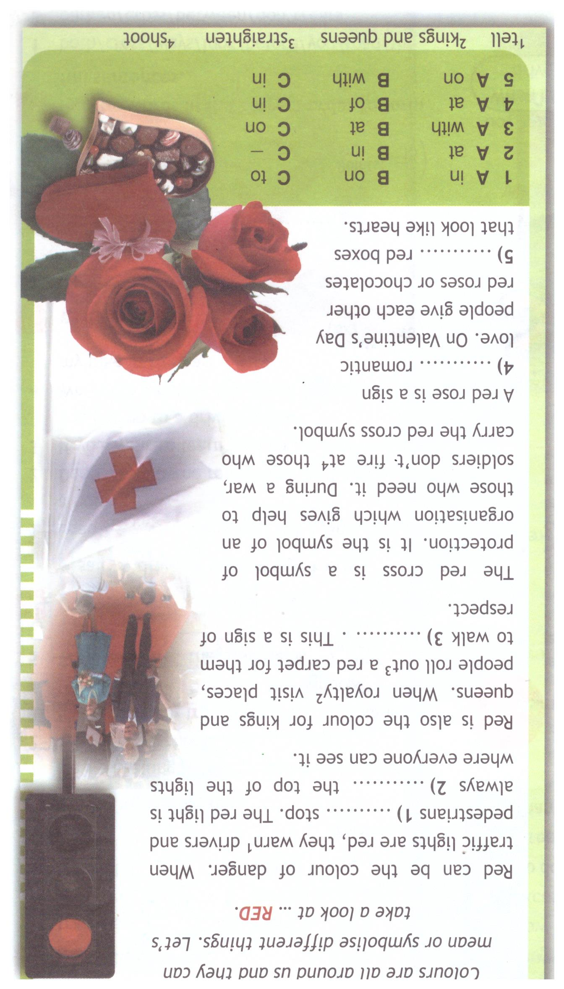
Come up with a title for the text

Slide 12
Homework
Choose any colour and tell us about it.
What can it mean?
What is it used for?

Slide 13
Thanks for your attention!

Slide 14
Оригинальные шаблоны для презентаций: https://presentation-creation.ru/powerpoint-templates.html
Бесплатно и без регистрации

